Slide 1
Career Coaching 1st Step
Welcome to the Saddleback Career Coaching ministry!

Slide 2
Agenda
Ministry Overview
Career Management Process
Finding Focus
Notes:
Review the Objectives of the module and what participants will be able to accomplish at the end of the module.
Given an overview of the Ministry, you will know:
The Ministry’s purpose and how we can help you during your transition
How to access Ministry information to help you with areas of immediate need, including:
Classes in important career development topics
A range of tools you can use
Individuals you can network with
How to apply the information learned to improve your career
Take a moment before moving forward to ask the attendees the questions below:
What’s different about looking for a job in today’s environment?
Are you doing anything differently then the last time you looked for a job?
Do you feel your are well prepared to find your next job?
What kinds of things would help you during your job search?
What are your expectations pertaining to this ministry?

Slide 3
Ministry Overview

Slide 4
Ministry Overview
Serving Orange County since 2001!
Free
Every Monday (excluding holidays & church events)
LinkedIn Thursdays
Notes:
16+ years of continuous service every Monday evening
Free outplacement that rivals professional programs
Network Mixer – Quarterly
Classes are taught the intervening Mondays (like tonight!)
Our core value is the comprehensive set of classes
Plus many other resources are available, e.g., One-On-One Coaching
LinkedIn on Thursdays in the Children’s Building
Our program works! (But you must work the program)

Slide 5
Ministry Resources
Weekly classes
Volunteers
Prayer table
1-on-1 coaching
Ministry website

Slide 6
Ministry Classes
Weekly
Career Coaching 1st Step
Personal Branding
Resume
Interviewing
Mock Interviews
Standard LinkedIn¹
1-on-1 Coaching
Rotating
Using LinkedIn to Target Companies
Advanced LinkedIn
Salary Negotiations²
¹ Offered every Thursday (excluding Holidays & Church Events)
² Offered once a quarter

Slide 7
PICS Ministry
Free Professional Photographs
6:30pm – 7:30pm
Dates announced in advance
Notes:
PICS Ministry
Free professional photograph (come dressed appropriately)
Only once a quarter
Available within three days to download for free
Use on LinkedIn, networking cards, wherever else you need it

Slide 8
Our Career Course Roadmap
Intro
Career Coaching First Step
Level 1
Personal Branding
Level 2
Resume
Standard LinkedIn
Advanced LinkedIn
Using LinkedIn to Target Companies
Level 3
Interviewing
Mock Interviews
Salary Negotiations
1-on-1 Coaching

Slide 9
Personal Branding
1st step of search process
Differentiate yourself from other applicants
Power Stories (PAR statements)
Elevator Speech
Working your brand

Slide 10
Resume
Formatting your resume
Customizing your resume
Powerful, quantifiable accomplishments
Acceptable resume formats
Cover letters

Slide 11
Standard LinkedIn¹
Why is LinkedIn Necessary?
Advanced LinkedIn²
LinkedIn Check-up
Using LinkedIn to Target Companies²
Target Companies: Why and What
Goals of LinkedIn
LinkedIn Components
Profile Essentials
Your Network
Grow a Network
Cultivate Relationships that Work for You
Maintain Relevancy & Currency
Raise Your Brand
How to Develop Target Company Lists
Strategies to “Break Into” Target Companies
¹ Offered every Thursday (except Holidays & Church Events)
² Offered on a rotating basis (check the ministry schedule)

Slide 12
Interviewing
Research and prepping for the interview
Phases of the interview
How to answer “Tell me about yourself”
Approaches for different interview types
Post-interview follow up

Slide 13
Mock Interviews
Practice an interview
Recorded
Live feedback
Sign up in advance – saddleback.com/careercoaching
*Prior attendance of specific courses required

Slide 14
Salary Negotiations
Salary negotiation guidelines
Rules of negotiation
What is negotiable
Counteroffer tips

Slide 15
1-on-1 Coaching
Catered to you
Variety of specialties
There’s always someone who can help you
Not part of suggested order, go any time

Slide 16
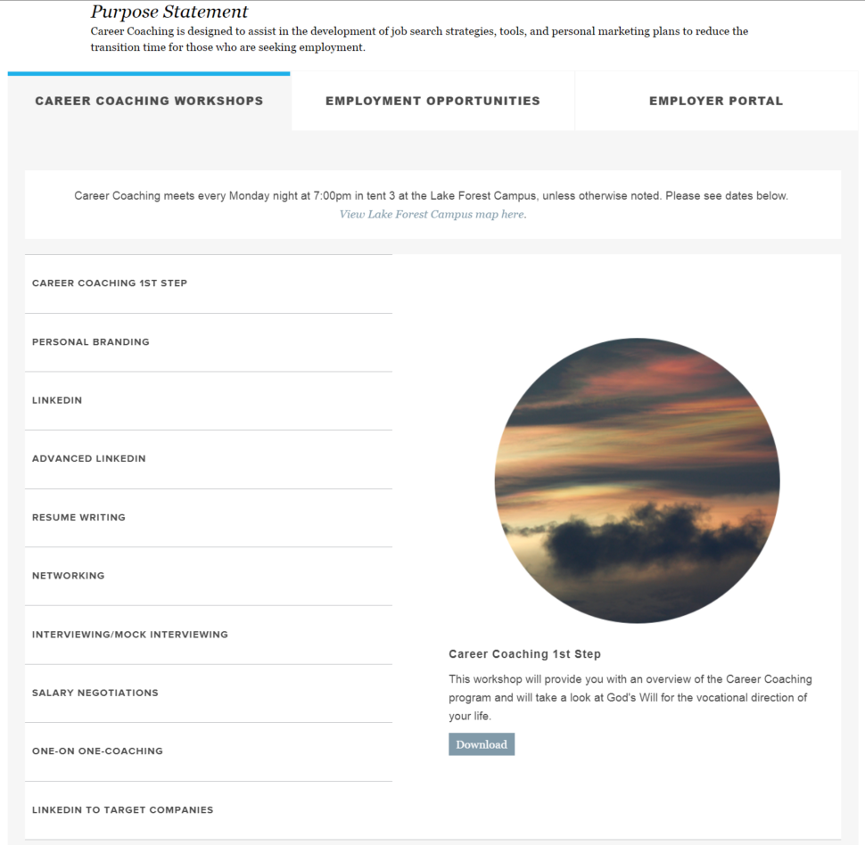
Ministry Website
Handouts
Additional Resource Downloads
Volunteer Information
Mock Interview Signup
…and much more!
saddleback.com/careercoaching
Notes:
- Schedules - Directions - Course Information Downloads - Volunteer Information - Network Mixer Information - Mock Interview Signup Sheet - Contact Information - Much More

Slide 17
Career Management Process

Slide 18
7 Stages of Grief
Shock & Denial
Pain & Guilt
Anger & Bargaining
Depression, Reflection, & Loneliness
Upward Turn
Reconstruction (working through)
Acceptance & Hope
Notes:
Based on research with the terminally ill by Elizabeth Kübler-Ross which she determined could apply to anyone experiencing a loss

Slide 19
Time Management
You are not here by accident!
Use your time wisely
Transition plan
80/20 rule
Networking
Help others
Notes:
Acceptance – You are not here by accident!
Use your time wisely
Don’t spend all your time looking for a job!
Take stock of YOU (marketing tools, marketing communications, ability to sell yourself, salary negotiations)
Establish your transition plan
Do the right things (80/20)
Networking and Accountability Groups
Help others and let others help you

Slide 20
Establishing Your Plan
Determine your plan
Create your plan
Schedule your time
Execute
Notes:
Assess and address your weaknesses
Low hanging fruit and the 80/20 rule
Critical path - Which classes should I take first?
Create your transition plan and schedule your time
Data gathering
Networking events
Accountability groups . . .

Slide 21
Accountability Groups
Accountability Partner
Provide feedback & advice
Keep you on track
Provide encouragement
Transitioning in the workplace – women
2nd Tuesday of the month from 6:30-8:30pm

Slide 22
Career Management Process
Establish Your Plan
Establish Your Brand
Communicate Your Value
Sell Yourself
Negotiate Your Value
Career Management
Personal Branding
Resume
LinkedIn
Targeting Companies
Interviewing
Salary Negotiation
Notes:
Establish Your Plan
Accountability Group
Personal Branding
Marketing Materials, Resume Writing
Marketing Communications
Networking, Targeting Companies, LinkedIn Workshops
Selling Yourself
Interviewing
Negotiating Your Value

Slide 23
Next Steps
Assess your strengths & weaknesses
Establish your transition plan
Explore ministry website
Find an Accountability Partner
Start networking
Come back next week!

Slide 24
Finding Focus

Slide 25
Objectives
Understand your situation
Strengthen your faith
Connecting with God and others
Notes:
Use this time of transition to look at your life and better understand your current situation
Strengthen your Faith and renew your commitment to Help Others

Slide 26
Attitude
The importance of Attitude
The longer I live, the more I realize the impact of attitude on life. Attitude, to me, is more important than facts. It is more important than the past, than education, than money, than circumstances, than failures, than success, than what other people think, or say, or do. It is more important than appearance, giftedness, or skill.
It will make or break a company, a church, a home. The remarkable thing is we have a choice everyday regarding the attitude we will embrace for that day. We cannot change our past, we cannot change the fact that people will act in a certain way. We cannot change the inevitable. The only thing we can do is play on the one string we have, and that is our attitude. I am convinced that life is 10% what happens to me and 90% how I react to it. And so it is with you. We are in charge of our attitude.
Charles Swindoll, Christian pastor, author, and educator

Slide 27
Prayer
Prayer is:
Honest
Humble
Personal
Powerful
Prayer will:
Give you wisdom when you are lost – James 1:5
Allow you to receive God’s peace – Philippians 4:6-7
Notes:
Prayer will:
Give you wisdom when you are lost – James 1:5
Allow you to receive God’s peace – Philippians 4:6-7
Prayer is honest and personal
Prayer provides guidance
Prayer is powerful – Miracles happen every day through prayer

Slide 28
Fellowship
Cultivate relationships that:
Provide support
Are uplifting
Strengthen you
Stimulate you
Provide encouragement
“Though one may be overpowered, two can defend themselves. A cord of three strands is not quickly broken. Ecclesiastes 4:12
Notes:
We find fullness of life through fellowship
We are designed for companionship, not isolation; for intimacy, not loneliness
There are advantages in cooperating with others
Two are better than one . . . If one falls down, his friend can help him up. But pity the man who falls and has no one to help him up! – Ecclesiastes 4:9-10
Though one may be overpowered, two can defend themselves. – Ecclesiastes 4:12
Cultivate relationships that provide support, are uplifting, strengthen you, stimulate you, and provide encouragement

Slide 29
Faith
Faith is believing without seeing
“Now faith is confidence in what we hope for and certain of what we do not see.” – Hebrews 11:1
Have faith that God has a plan for you, even if you can’t see what it is.
Notes:
Faith is being sure of what we hope for and certain of what we do not see. – Hebrews 11:1
This doesn’t happen overnight. It requires constant encouragement and reinforcement through Prayer, Bible Study, Fellowship, and Quiet Time
As Christians, we are required to “live by faith, not by sight.” – 2 Corinthians 5:7
Faith is believing in what you know regardless of what you see
Look back on what He’s done for you, at your prayers He’s answered

Slide 30
Next Steps
Set time aside with a One on One Coach
Commit to completing the Career Coaching program
Come back next week!

Slide 31
Our Career Course Roadmap
Intro
Career Coaching First Step
Level 1
Personal Branding
Level 2
Resume
Standard LinkedIn
Advanced LinkedIn
Using LinkedIn to Target Companies
Level 3
Interviewing
Mock Interviews
Salary Negotiations
1-on-1 Coaching

Slide 32
May God Bless You and Guide You During Your Transition
Thank You
saddleback.com/careercoaching
Notes:
Any final questions?
Be sure to come back next week for the next class in improving your job search skills or for one-on-one coaching.
Please give us your feedback!

